Slide 1

Joy Pal
ID : 201002418
Sec: 203DA
Dept. of CSE
Green University

Slide 2
Problem 1: Pinocchio
Implement
Algorithm
#include<stdio.h>
#include<math.h>
int main()
{
int T,n,l,i,t=0,p;
int a[100];
printf("Enter numbers : ");
scanf("%d", &T);
Start
Declare some integers
Declare 1 integer type array
Take integer from user
Store the data with the help of “scanf function”

Slide 3
Implement
Algorithm
while(T--)
{
scanf("%d", &n);
for(i=1; i<=n; i++)
{
scanf("%d", &a[i]);
}
i=0;
p=2;
Start a while loop
Store the data
Start a for loop which is start from 1
Read integer and store at in a[i]
Says that , “ i=0 & p=2 ”

Slide 4
for(i=1; i<=n; i++) { if(a[i]>p) { l+=ceil((a[i]-p)/5); p = a[i]; } printf("Case %d : %d\n", t++, l); } } return 0; }
Implement:
Algorithm
Start for loop which is also start from 1
Use if statement (a[i]>p)
Use the formula “l+=ceil((a[i]-p)/5);”
And says that p = a[i];
Print the result
Stop

Slide 5
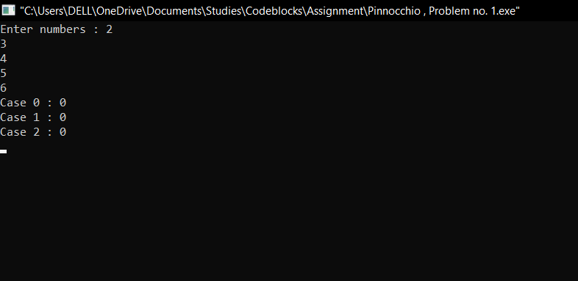
Input & Output:

Slide 6
Problem 2: Chocolate Thief
Implement
Algorithm
#include <stdio.h>
#include <string.h>
int main ()
{
int a, b, c, test, k, n,l, v, max, min, i;
char str[21], s1[21],s2[21];
printf("Enter the test cases : ");
scanf (" %d", &test);
Start
Declare some integer
Declare 3 character type string
Take integer from user
Store the data at the address

Slide 7
for (k = 1; k <= test; k++) { scanf("%d",&n); scanf("%s%d%d%d",str,&a,&b,&c); max=min=a * b * c; strcpy (s1,str); strcpy (s2, str);
Implement
Algorithm
Start for loop
Store the integer at the n address
Scan the data for string a, b & c
Use max = min = a*b*c
String copy the data of s1 at str
String copy the data of s2 at str

Slide 8
for (i = 1; i < n; i++) { scanf ("%s%d%d%d",str,&a,&b,&c); v = a * b * c; if (v > max) { strcpy (s1 , str); max = v; } else if (v < min) { strcpy (s2 , str); min = v; }
Implement
Algorithm
start for loop
Store the data of string at a, b & c address
Use “v = a*b*c”
Use if statement (v>max) , max = v
Use else if statement (v<min) , min = v

Slide 9
} if (max == min) printf ("Case %d: no thief\n", k); else printf ("Case %d: %s took chocolate from %s\n", k, s1, s2); } return 0; }
Implement
Algorithm
Use If statement for the test equality (max == min)
Print Case for no thief
Use else statement for the case of there is any thief
stop

Slide 10
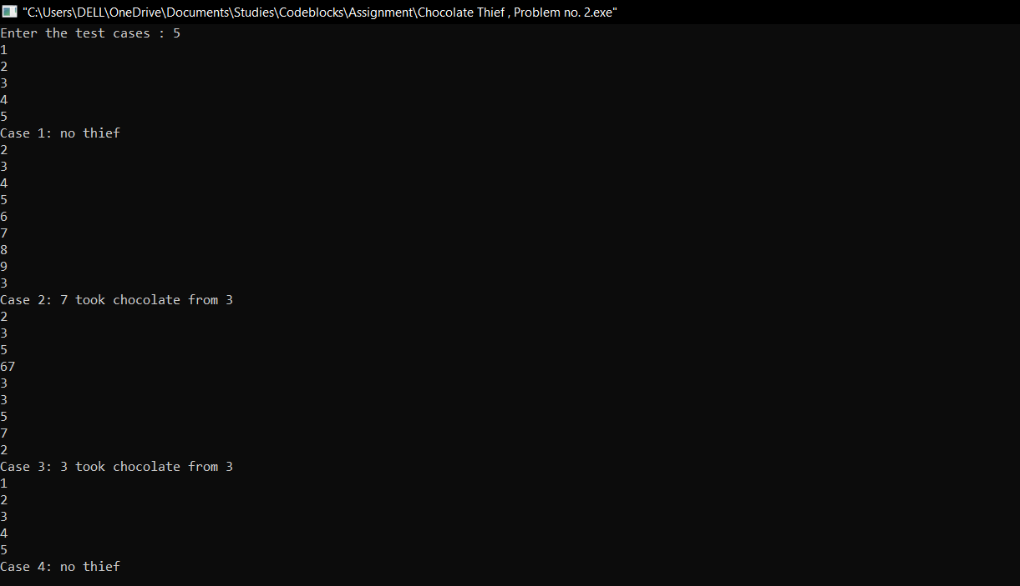
Input & Output

Slide 11
Problem 3: Hidden Secret!
Implement
Algorithm
#include <stdio.h>
#include <string.h>
int main()
{
int tst, i, j, cndtn;
char a[120], b[120];
printf("Enter the number : ");
scanf("%d", &tst);
getchar();
Start
Declare some integer
Declare 2 character type string
Print the number and store the data at the address of tst

Slide 12
for(i=1; i<=tst; i++) { int a1[26], b1[26]; for(j=0; j<26; j++) { a1[j] = 0; b1[j] = 0; } gets(a); gets(b);
Implement
Algorithm
Start for loop which is start from 1
In for loop declare 2 integer type array
Use for loop which is start from 0 and end at 26
Says that a1[j] = 0 & b1[j] = 0
Read line a
Read line b

Slide 13
Thank You…..

